Slide 1

sdev1701
Day 20: Prototyping tools / Mapping user flows and site architecture.

Slide 2
Visualizing Multichannel User Experiences

Slide 3
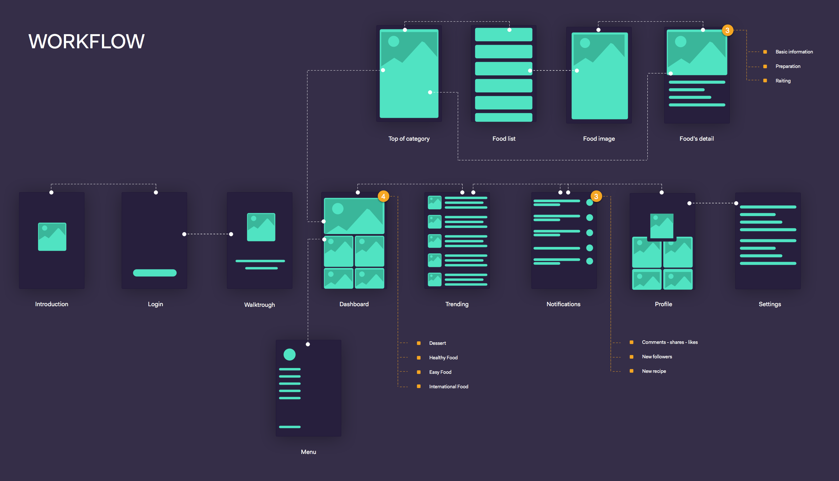
What is User Flow
User flow is a visual representation of the sequence of actions a user takes to achieve their goal on a website or in an application. It is a flow chart that visually displays each step the user takes from the entry point to reaching the final goal.

Slide 4
Why Use user flow?
Consistency across channels builds user trust
Poor alignment causes confusion, frustration, and drop-off
Mapping helps us identify design gaps and improve interactions
Used in UX research, audits, and service design

Slide 5
When and Why to Use User flow
1. Before starting work on a project
In this case, you will be able to determine the scenario and the necessary functions of the future product in advance.
2. During the work on the project
Creating a User Flow at this stage will help you make edits, reconsider the need for old features and capabilities, or add new ones.

Slide 6
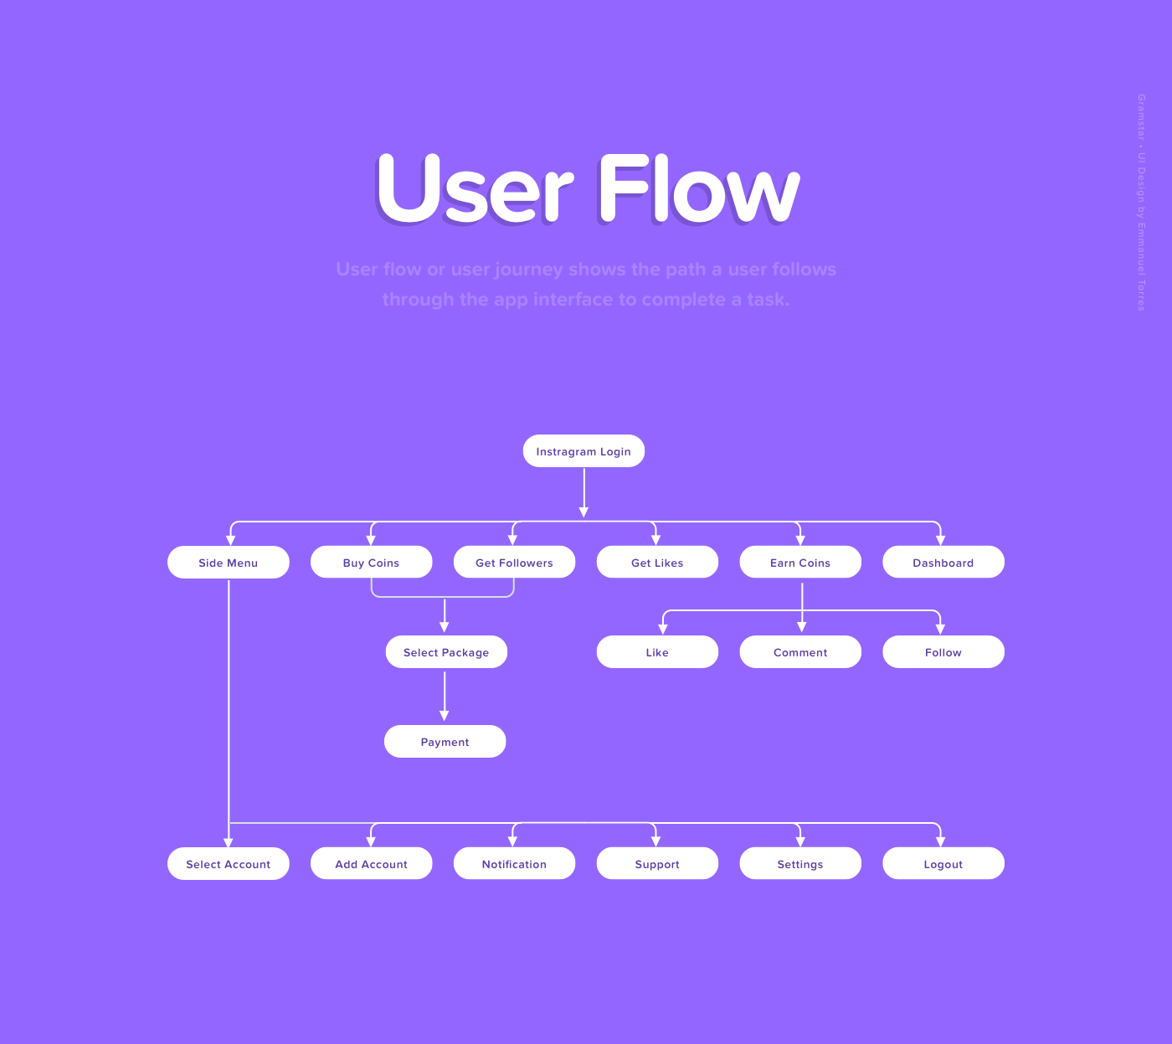
When and Why to Use User Flow
Focus on creating an intuitive interface with a clear sequence of steps to achieve the user's goal.
Assess whether the finished interface is suitable for solving the given task.
Involve the team in the development of the project and motivate them to ask the right questions that will be aimed at improving it and finding problem areas.
Visually demonstrate to the team and the client the logic of the product, as well as the options for its development.
It is better to imagine and understand the user, their way of thinking and the sequence of actions.
Ensure more effective communication between managers, designers and developers, and thus avoid many mistakes.

Slide 7

Who benefits from User Flow
Designers
Gain the ability to create user-centric designs.
Developers
They are freed from having to ask a lot of questions about the logic of processes and their functioning. They can work more efficiently, avoiding the need to make many edits and rewrite code.
Project managers
They can distribute tasks between specialists more quickly.

Slide 8
Who benefits from User Flow
Marketers
Use User Flow to evaluate sales funnels.
Customers
They receive a high-quality and profitable product, because it takes into account the convenience of users. In addition, preliminary development of the User Flow can save the client's time and money.
Users
They get the opportunity to interact with a convenient and comfortable interface.

Slide 9
Types of User Flow
1. Linear User Flow
Contains only the user's main steps in the interface that lead them to achieving the goal; possible options and branching paths are not provided.
2. Conditional User Flow
It means that the user can choose one of the paths among several options. In addition, the interface includes various reactions to each possible user choice.

Slide 10
Types of User Flow
3. Modular User Flow
As the name suggests, a modular flowchart for User Flow combines individual modules into a single diagram. They describe the steps for using individual features of an app or website.
4. Parallel User Flow
This type of User Flow includes a description of several parallel actions. It is used when the interface assumes that the functions can be used simultaneously. Such a flowchart also contains the interface responses to these actions.

Slide 11
How to create a User Flow

Slide 12
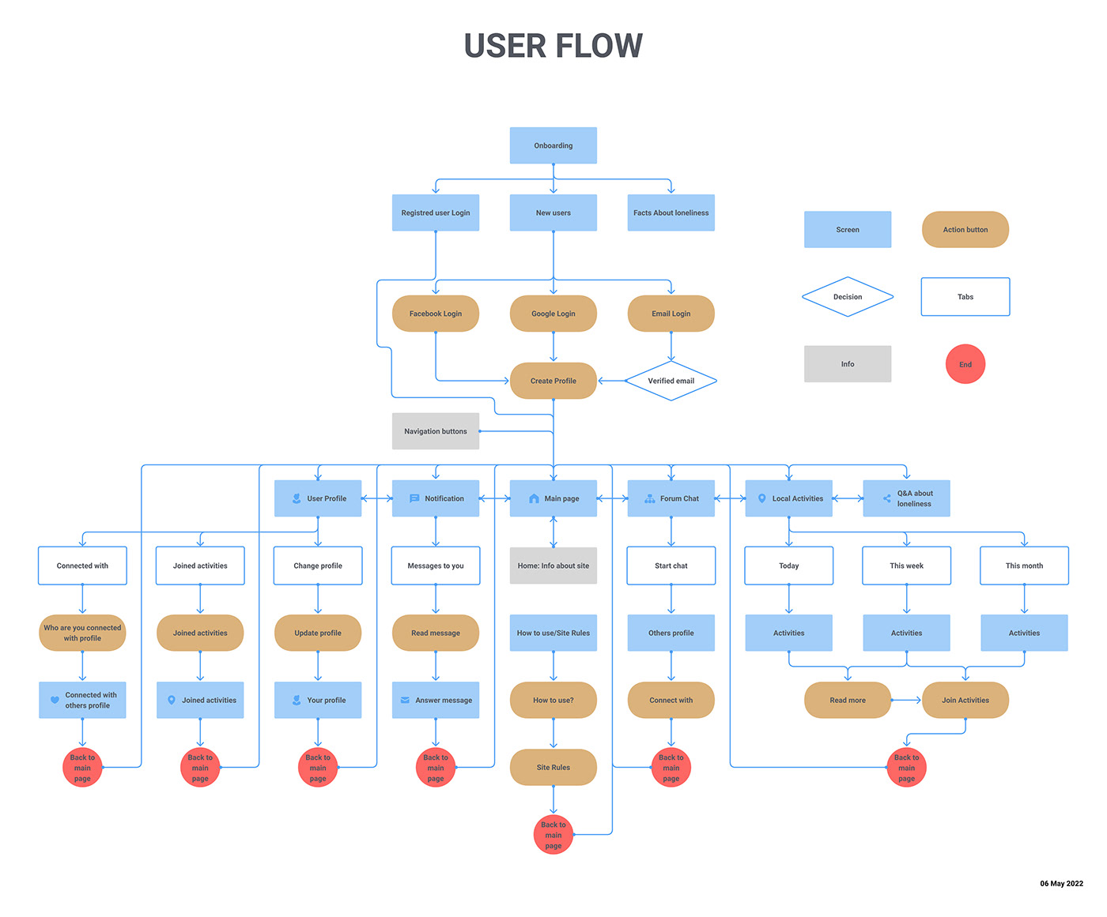
Block diagram element designations
So, each User Flow diagram consists of different geometric shapes. Each has its own meaning.

Slide 13
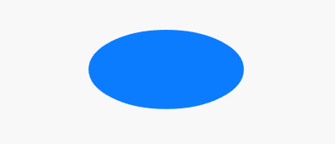
Block diagram element designations
Circle or oval - the beginning and end of the scenario.

Slide 14
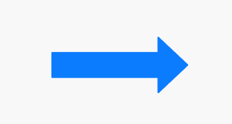
Block diagram element designations
An arrow is the direction of the user's movement in the scenario. They can point in any direction, intersect, and even send back.

Slide 15

Block diagram element designations
The rectangle is the action the user needs to take to move forward in the scenario.

Slide 16
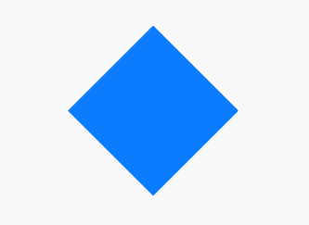
Block diagram element designations
A diamond is a decision or choice that the user must make if they have multiple options.

Slide 17
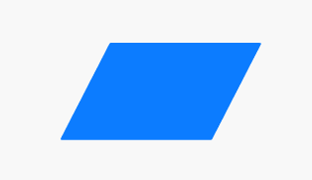
Block diagram element designations
Parallelogram - input or output of new information.

Slide 18
Step-by-step instructions

Slide 19
Step 1
Find out from the customer:
The goals of the product;
What functions and features the interface should contain;
What actions are expected from users?
For example, the customer is a ready-to-eat healthy meal delivery service; they need an app through which customers can order food.

Slide 20
Step 2
Describe your user in detail. To do this, you can create a persona of the user.
For example:
Name - Valeria.
Age - 31 years.
Profession: manager of managers in a school of foreign languages.
Interests and hobbies: healthy lifestyle, sports, beauty, self-development.
The goal the user wants to achieve with your product is to save time preparing healthy meals.
The needs that the user wants to satisfy are ready-made tasty and healthy breakfast, lunch and dinner, which take into account the required amount of calories; more free time.
The problem your product should solve for the user is that it takes 2-3 hours to cook; it is difficult to calculate the caloric content of food per day.
The motivation that drives the user is saving time, the desire to stay in shape and be healthy.
Expectation is how the user imagines interaction with the interface and the result. For example, Valeria imagines that she will go to the application, indicate the required number of calories and choose the appropriate set of dishes.

Slide 21
Step 3
Think about a scenario (situation) in which a user might use your product.
Example: Valeria gets tired at work and doesn't want to cook food for several days in the evening, so she orders ready-made meals 3 days in advance during the day. She also chooses the delivery time so that when the courier brings the order, she has already returned from work.

Slide 22
Step 4
Describe schematically the sequence of user actions from point A to point B:
Identify the entry point (where the user's journey begins and what conditions the user is in).
To do this, analyze how the user gets to your application, for example, through a search query, social network, advertising, SMS, email, etc. The appearance of the first screen that the user lands on will depend on this.
For example, Valeria saw an ad for the app from a fitness blogger, and she got interested and downloaded it just in case. At work, she thought about dinner and remembered that she had a promo code for her first order. So she opens the app.
2. Consider how the user will navigate the application; what sequence of actions will lead to the desired result?

Slide 23
Step 4
Example:
Valeria finds herself on the main screen of the application and sees several sections: breakfasts, lunches, dinners, snacks and meals for the whole day.
She selects the last option and is taken to a new screen where she needs to specify the required number of calories.
From the proposed list, she chooses ready-made food for 3 days.
Then she goes to the cart, fills out the form with the address and contacts, enters the promo code from the blogger and pays for the order.
After that, she sees a notification about the order confirmation and its status, as well as the delivery time.
Indicate choice points where the user must make a decision; indicate transitions and connections between blocks.
At this stage of User Flow development, you need to connect the route from the previous point into one flowchart using the elements we wrote about above.

Slide 24
Step 5
Supplement the User Flow with secondary elements; these include:
notifications,
hints,
pop-up windows.

Slide 25
Step 6
Find out what bottlenecks (problem areas) your scheme has. Offer the user a solution right away.
For example, some users may be allergic to certain products. In the dish description, immediately indicate that some ingredients can be removed if you leave a comment on the order.

Slide 26
Step 7
Complete the resulting User Flow using one of the programs we will discuss below.

Slide 27
Programs for creating User Flow

Slide 28
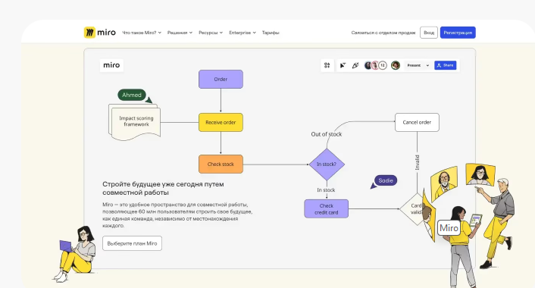
Miro
This resource was created specifically for creating mind maps, so it is convenient to display any schemes in it. In addition, it has ready-made templates for User Flow.
miro.com

Slide 29
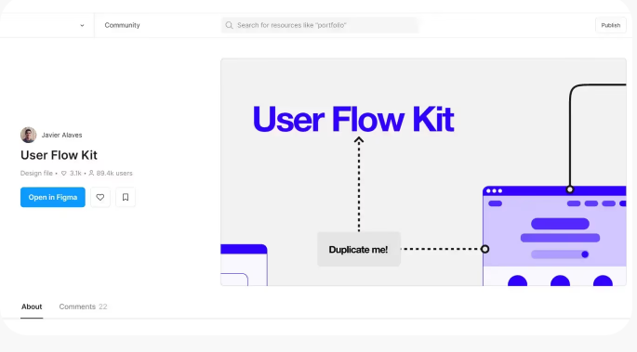
Figma
There are various options for working with flowcharts in Figma, such as the built-in Fig Jam or the UX Flow template.

Slide 30
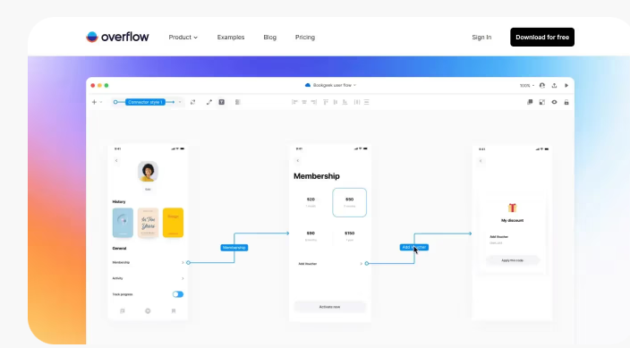
Overflow
The advantage of this tool is that ready-made flowcharts can be integrated with popular tools such as Figma or Sketch.
overflow.io

Slide 31
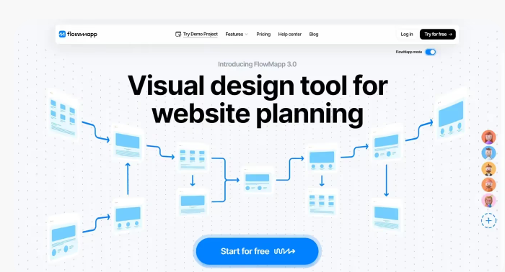
Flowmap
Another online tool. It also allows you to create User Flows, but some of the features are paid.
flowmapp.com

Slide 32
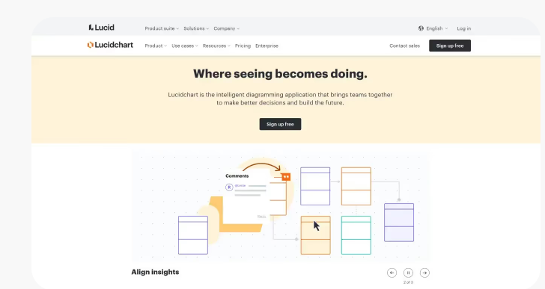
Lucidchart
This tool supports collaborative work on a project and also offers a wide range of settings for functions and appearance of diagrams. The resource is paid, but it has a free trial period.
lucidchart.com

Slide 33
Tips for developing User Flow

Slide 34
Tips for developing User Flow
The name of your User Flow should immediately indicate what it is about. This will make it much easier for you to understand the working file.
Try to make sure that the User Flow moves in one direction and is consistent. Also, avoid unnecessary branches and feedback windows.
One User Flow should correspond to one goal or function. If your interface is designed to solve several problems, create a separate User Flow for each of them.

Slide 35
Tips for developing User Flow
Create a User Flow Legend. This is an explanation of the various shapes and elements in your flow chart.
Use simple language and clear wording: The User Flow should be understandable to all team members.
Don't overdo it with colours. They help highlight important points, but if you overdo it, colours can make the User Flow as a whole hard to read.
Make sure that the User Flow is aligned with the goals and objectives of the business, i.e. it works in favour of your client.

Slide 36
INTERACTIVITY, FLOWS, AUTO LAYOUT, VARIANTS

Slide 37
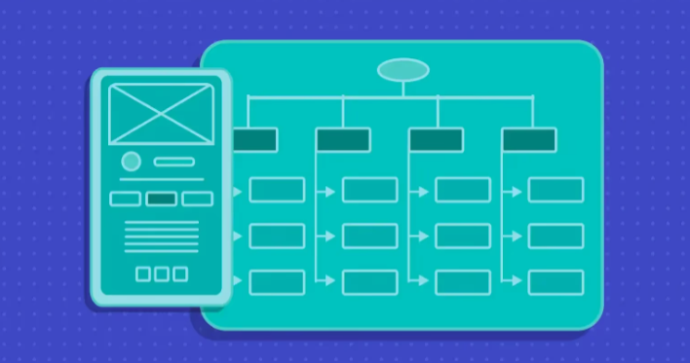
What is Information Architecture (IA)?
Information architecture is the invisible “map” of a website. In order for users to perceive the content and navigate the interface, the information needs to be organized in a certain way. This is the job of an information architect.
When you visit a website, you most often have a specific goal in mind. It could be to buy a product, get information, or simply send an email.
Most websites are designed so that you can achieve your goal with a minimum number of clicks and in a minimum amount of time. After all, the longer it takes to complete a task, the more likely you are to simply close the page and move on to another site.
If you come across a well-organized website or application where you can easily find the content you need, you have information architecture to thank for it .

Slide 38
What is Information Architecture (IA)?
Information architecture (IA) is responsible for the structure of content within a digital product. Hierarchy of elements, menus, labels, and search functionality help make every piece of information needed to complete a task accessible to users.
A well-thought-out information architecture is the basis for a convenient and easy-to-use product.

Slide 39
Why does Information Architecture (IA) play an important role in UX?
Information architecture (IA) plays a key role in UX design, along with other elements such as user research, wireframing, and visual design.
The primary focus of IA is on organizing content and making it accessible through tags, sitemaps, and navigation. Without information architecture that helps build logic and structure, content becomes inaccessible and useless.

Slide 40
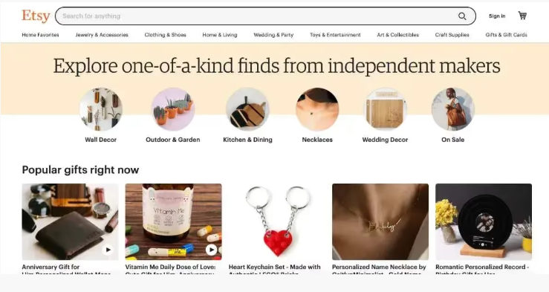
Why does Information Architecture (IA) play an important role in UX?
Imagine you're visiting Etsy to shop. You're immediately greeted by a clean layout with a prominent search field and product categories. Photos clearly showcase each item, making it easier for users to find the options they need based on their search terms, categories, or just the page.
Because the information architecture is well thought out, the purchasing process is simple and enjoyable.

Slide 41
Components of Information Architecture
To create a logical, continuous experience, an information architect uses 4 main components:
Organization: how information is structured and organized.
Labelling: how information is presented.
Navigation system: how users view or access information.
Search: How users search for information.

Slide 42
Components of Information Architecture
Designers who want to understand information architecture need to understand these components.
Moreover, they should set the following goal: to help users understand where they are at any given moment (on a website or within a product), what actions are available to them, and what to expect.

Slide 43
INFORMATION ARCHITECTURE DESIGN PROCESS

Slide 44
Step 1: Data collection and analysis
Information architects work with data from research, usability testing, and user-centred design methods. Interview your target audience and identify their goals to determine what they expect to see and achieve from a website or digital product.

Slide 45
Step 2: Reverse Engineering the Navigation Flow
Once you have collected the information, begin to structure the content using IA reverse engineering based on the user’s goals.
Make key elements your anchor points to ensure effective management of the process.
Each part of the site should be carefully designed and presented in a logical navigation flow to make it easy for users to move between screens

Slide 46
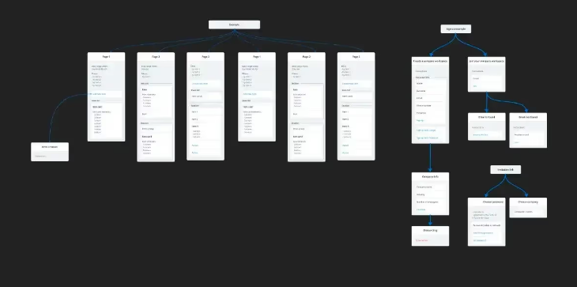
Step 3: Testing and Refinement
Information architecture is typically depicted as a visual flow chart that serves as a guide for the development team.
But like most elements in product design, it is constantly changing and requires refinement.
Over time, as you gain a better understanding of your users and the product itself, you will need to regularly adjust and refine the diagram.

Slide 47
Step 3: Testing and Refinement
Information architecture is typically depicted as a visual flow chart that serves as a guide for the development team.
But like most elements in product design, it is constantly changing and requires refinement.
Over time, as you gain a better understanding of your users and the product itself, you will need to regularly adjust and refine the diagram.

Slide 48
Tools for creating information architecture
There are many great flowchart apps that allow you to design and edit IAs with minimal effort. It requires minimal clicks, but the process is sure to be engaging.
Some of the most popular options are:
Lucidchart
Omnigraffle
Diagrams.net
Figma
Adobe XD
InVision

Slide 49
Principles of Information Architecture

Slide 50
Principle 1: Objects
The first principle involves simple analysis: identify what objects you are working with and how they function when the user interacts with them.
“Think of content as a living, breathing being with a life cycle, behaviour, and distinctive characteristics.”
Dan Brown

Slide 51
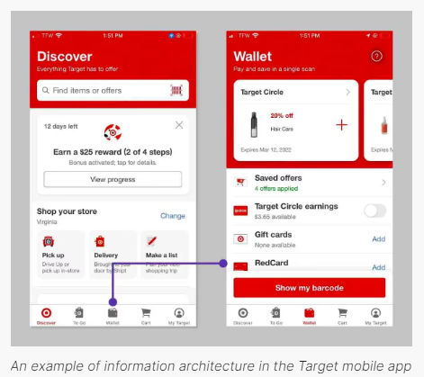
Principle 2: Choice
Too many choices overwhelm users and lead to inaction. An information architect must find a way to reduce cognitive load by displaying the right options at the right time.
Example:
The icon menu in the Target mobile app helps users quickly switch between different tasks: making purchases, viewing their cart, changing account settings, etc.

Slide 52
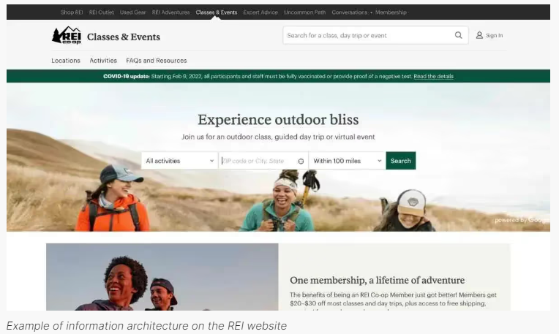
Principle 3: Disclosure of Information
Creating a usable interface requires more than just removing content. The principle of disclosure suggests that you should provide users with enough visual and textual cues so that they learn as they interact with the product.
Example:
REI "hides" the list of available classes on the Classes & Events page with clever search and filtering features. This prevents the overload or confusion that would otherwise occur if you had to sift through a long list of classes that don't match your location. It's also an effective way to find the content that you're really interested in.

Slide 53
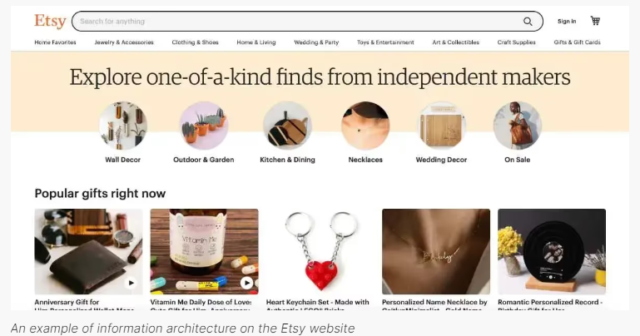
Principle 4: Samples
No matter how intuitive your navigational mental models are, text links don’t always speak for themselves. Add images to show what users will see when they select a particular item or category.
Example:
Buying handmade goods is a visual and textual experience. Even though Etsy is an online-only marketplace, images play a big role in helping shoppers navigate the different products and categories.

Slide 54
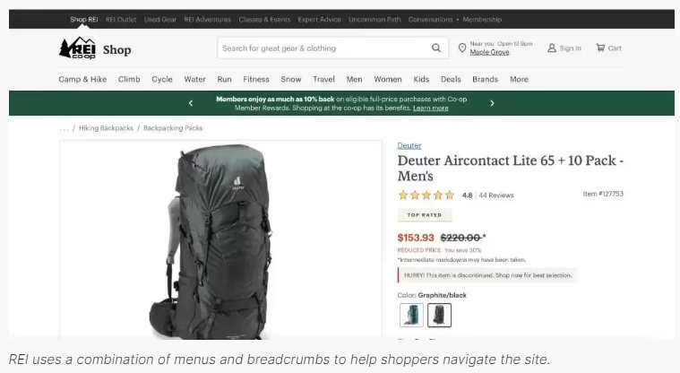
Principle 5: Entrance Doors
While the home page of a website is usually designed to allow users to quickly and easily access other sections, it is important to remember that not all people access the site through it. Each page should be designed in such a way that users immediately understand where they are and where they need to go to achieve their goals.
Example:
Typically, designers use a combination of menus and breadcrumbs on websites to help users navigate and quickly move from one point to another.
E-commerce sites, in particular, make sure that the shopping cart icon remains prominently displayed no matter what screen you're on

Slide 55
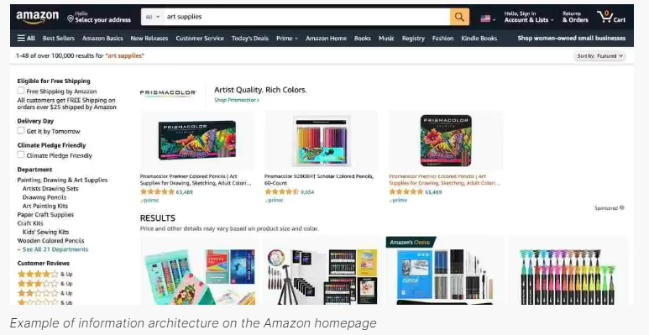
Principle 6: Multiple Classification
While you can make all pages accessible only through search, it’s better to provide a variety of ways for people to navigate and interact with your site. These methods, from navigation tools to visual hierarchy, should be carefully considered to fit the logic of both individual pages and the site as a whole.
Example:
Amazon's website not only has several top menus and a main search bar, but also a variety of filters in the left sidebar to filter out unwanted items from your search results.

Slide 56
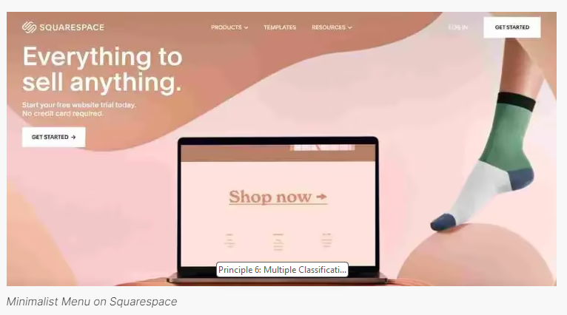
Principle 7: Logical Navigation
Navigation logic should remain consistent throughout the entire product experience. If you have a drop-down "Shop" list, the submenu items should correspond to and be limited to the product categories the user expects to see.
Example:
Known for its simplicity and ease of use, Squarespace's website header includes plenty of white space and logical menu items.

Slide 57
Principle 8: Growth
Because your product will grow and change over time, it's important that your content structure is scalable. Choose your categories carefully and try to strike a balance between "too general" and "too specific" when adding text labels and images.

Slide 58
Summary and Reflection

Slide 59
Reflection Prompt
How can user flow help improve workflow?

Slide 60
Next Steps:
User Flow Exercise:
Develop a user flow for a common digital task (e.g., booking a flight).
Identify potential pain points and suggest UX/UI improvements.

